Slide 1
Welcome to your reading lesson
You will need:
Whiteboard and whiteboard pen
Reading extract
Reading exercise book
Pencil

Slide 2
Lesson Expectations
Turn your camera on.
Mute your microphone.
Ready to learn.
Cold calling
Be present
Join in

Slide 3
The Legend of Podkin One-Ear
Step 2
Kieran Larwood

Slide 4
Vocabulary
What do these words mean?
trudging warren curse
woe betide beneath

Slide 5
The Legend of Podkin One-Ear
Kieran Larwood
Control The Game

Slide 7
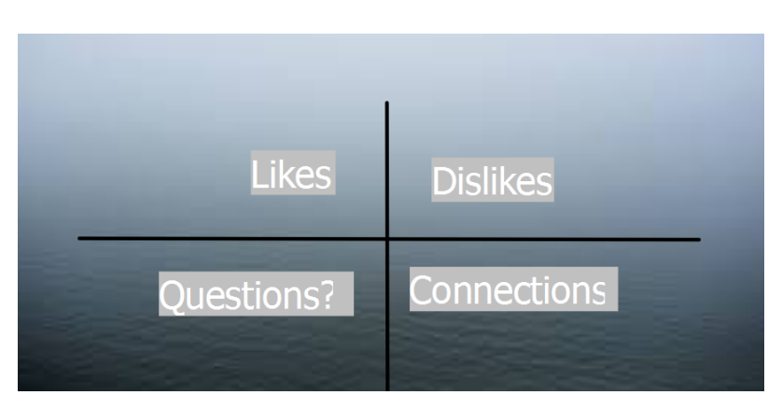

Slide 11
Connections
03.06.2020
TBS I will:
Write the title and short date.
Write what I like about the text.
Write what I don’t like.
Write any questions?
Write any connections.

Slide 12
Dojo Challenge
To earn your dojo points today you need to explain what you think this phrase means.
hard fought step
Type your answer in the Reading blog. I will publish these posts after 3.30pm.

